Slide 1
Biologically-based Error Driven Learning in Thalamocortical Circuits
Randall C. O’Reilly
University of Colorado Boulder
eCortex, Inc

Slide 2
Thalamocortical Mysteries
What is function of the alpha rhythm (10Hz)?
Why does higher-order thalamus have a few strong driver inputs, and far more weaker ones?
Why are these drivers non-plastic?
Last two seem strongly incompatible with neocortical plasticity!?

Slide 3
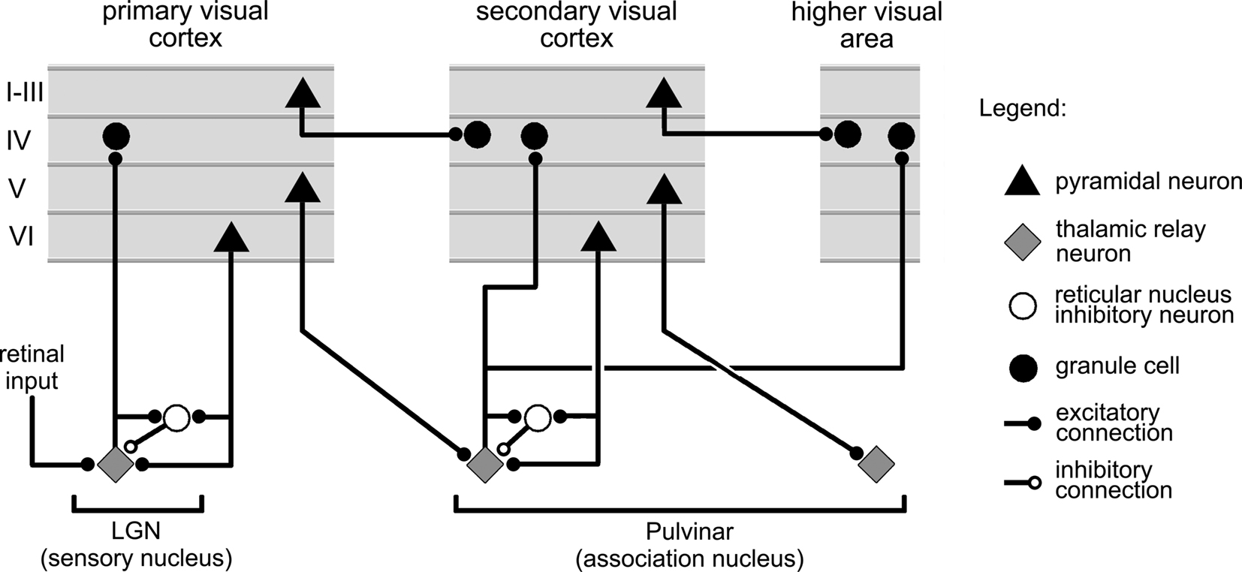
Sherman & Guillery

Slide 4
Overview
After 30 years, error-driven learning continues to be “what works”
Three major biological problems:
How to propagate errors? (solved; O’Reilly, 1996)
How does local synaptic plasticity work?
Where do supervised target values come from?

Slide 5
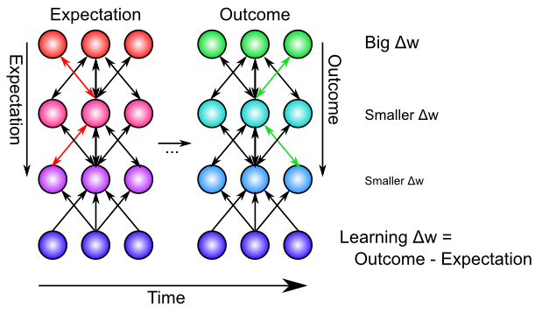
Bidirectional Connections Carry Error Gradients (GeneRec; O’Reilly, 1996)
Generalization of Recirculation (Hinton & McClelland, 1988)

Slide 6
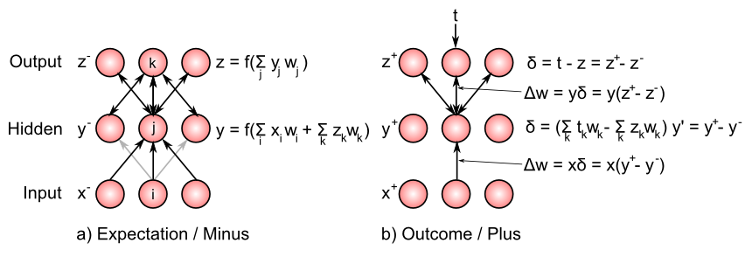
Bidirectional Connections Carry Error Gradients (GeneRec; O’Reilly, 1996)

Slide 7
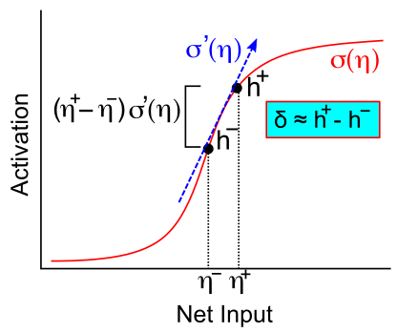
Activation Diffs Implicitly Compute Derivatives (GeneRec; O’Reilly, 1996)
Free to use arbitrarily complex activation functions!

Slide 8
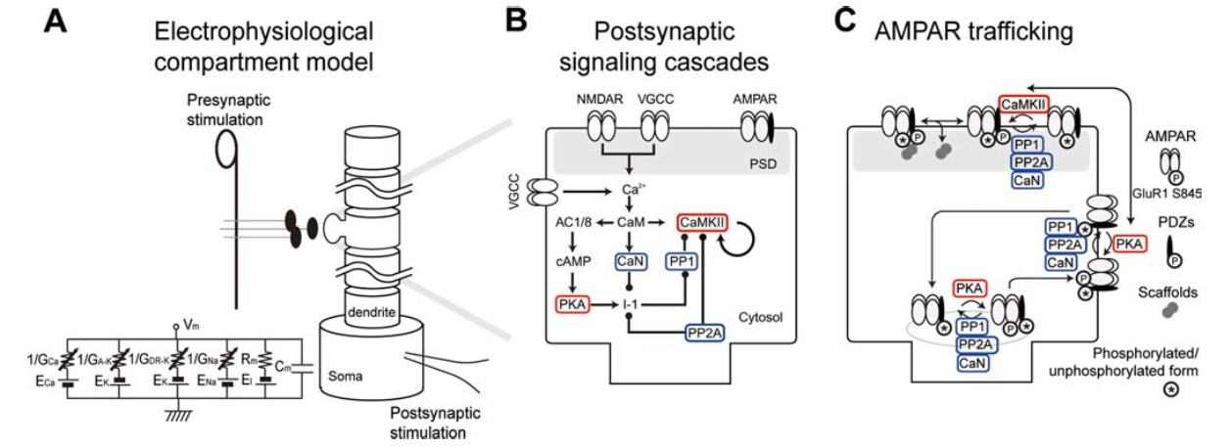
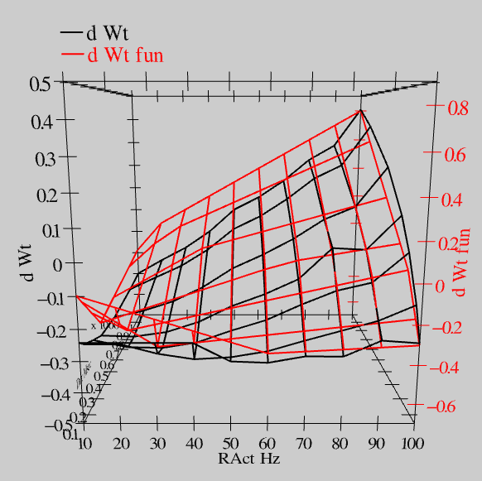
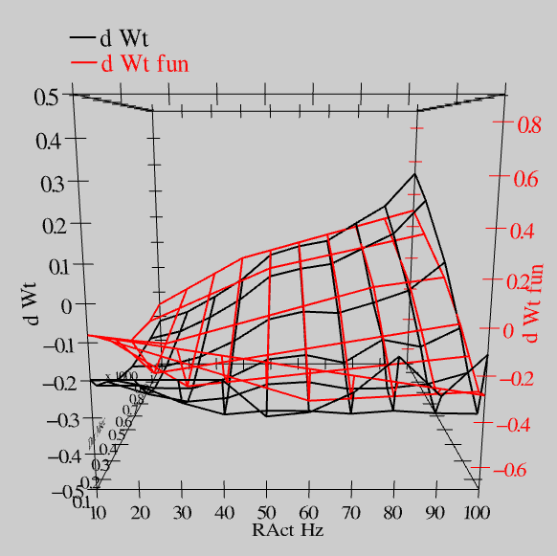
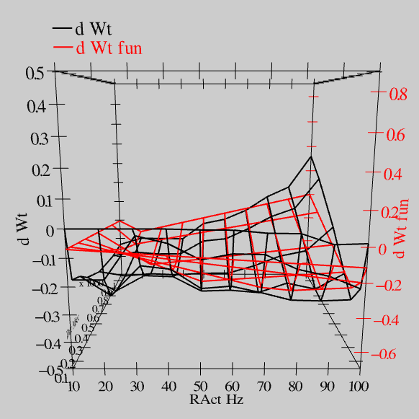
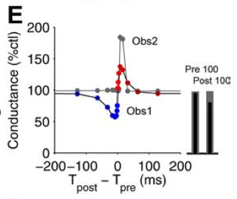
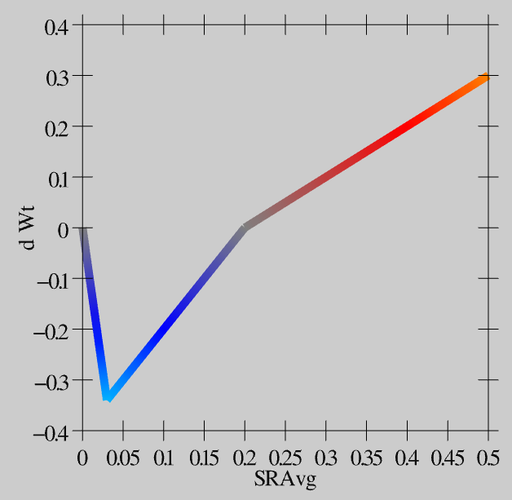
Synaptic Plasticity: XCAL Model (reduction of Urakubo et al, 2008 STDP model)
S = 100Hz
S = 50Hz
S = 20Hz
dW = f(send * recv) =
(spike rate * duration)
r=.894

Slide 9
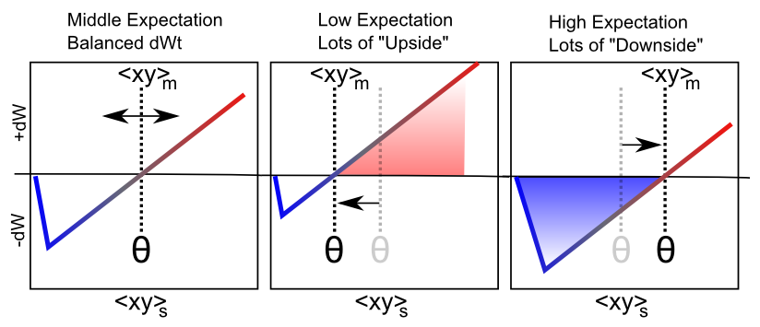
Floating Threshold = Medium Term Synaptic Activity (Error-Driven)
dW = Outcome – Expectation = <xy>_{s} - <xy>_{m}

Slide 10
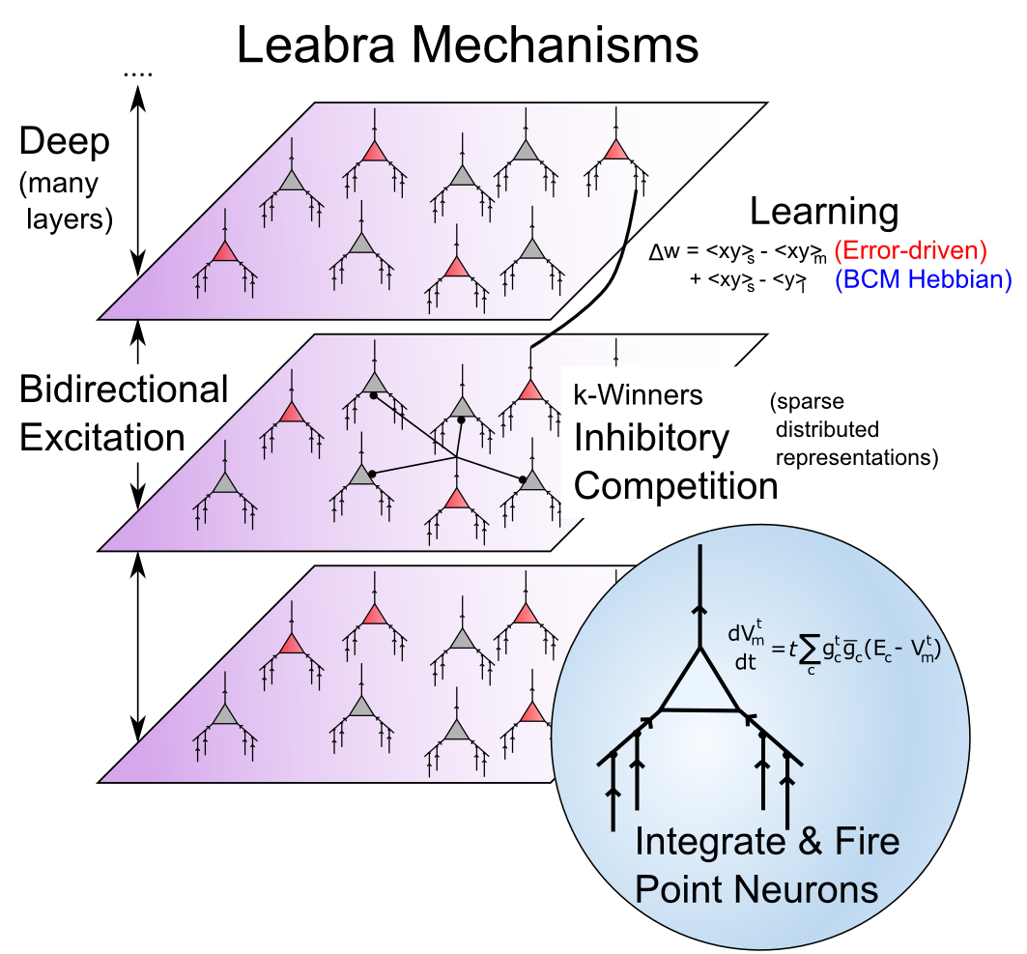
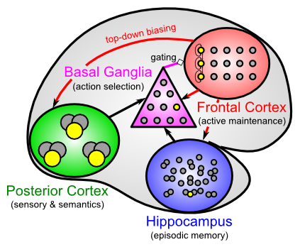
Leabra Biologically-based Cognitive Architecture
Same framework accounts for wide range of cognitive neuroscience phenomena: perception, attention, motor control and action selection, learning & memory, language, executive function – all built out of the same neurons.
http://ccnbook.colorado.edu

Slide 11
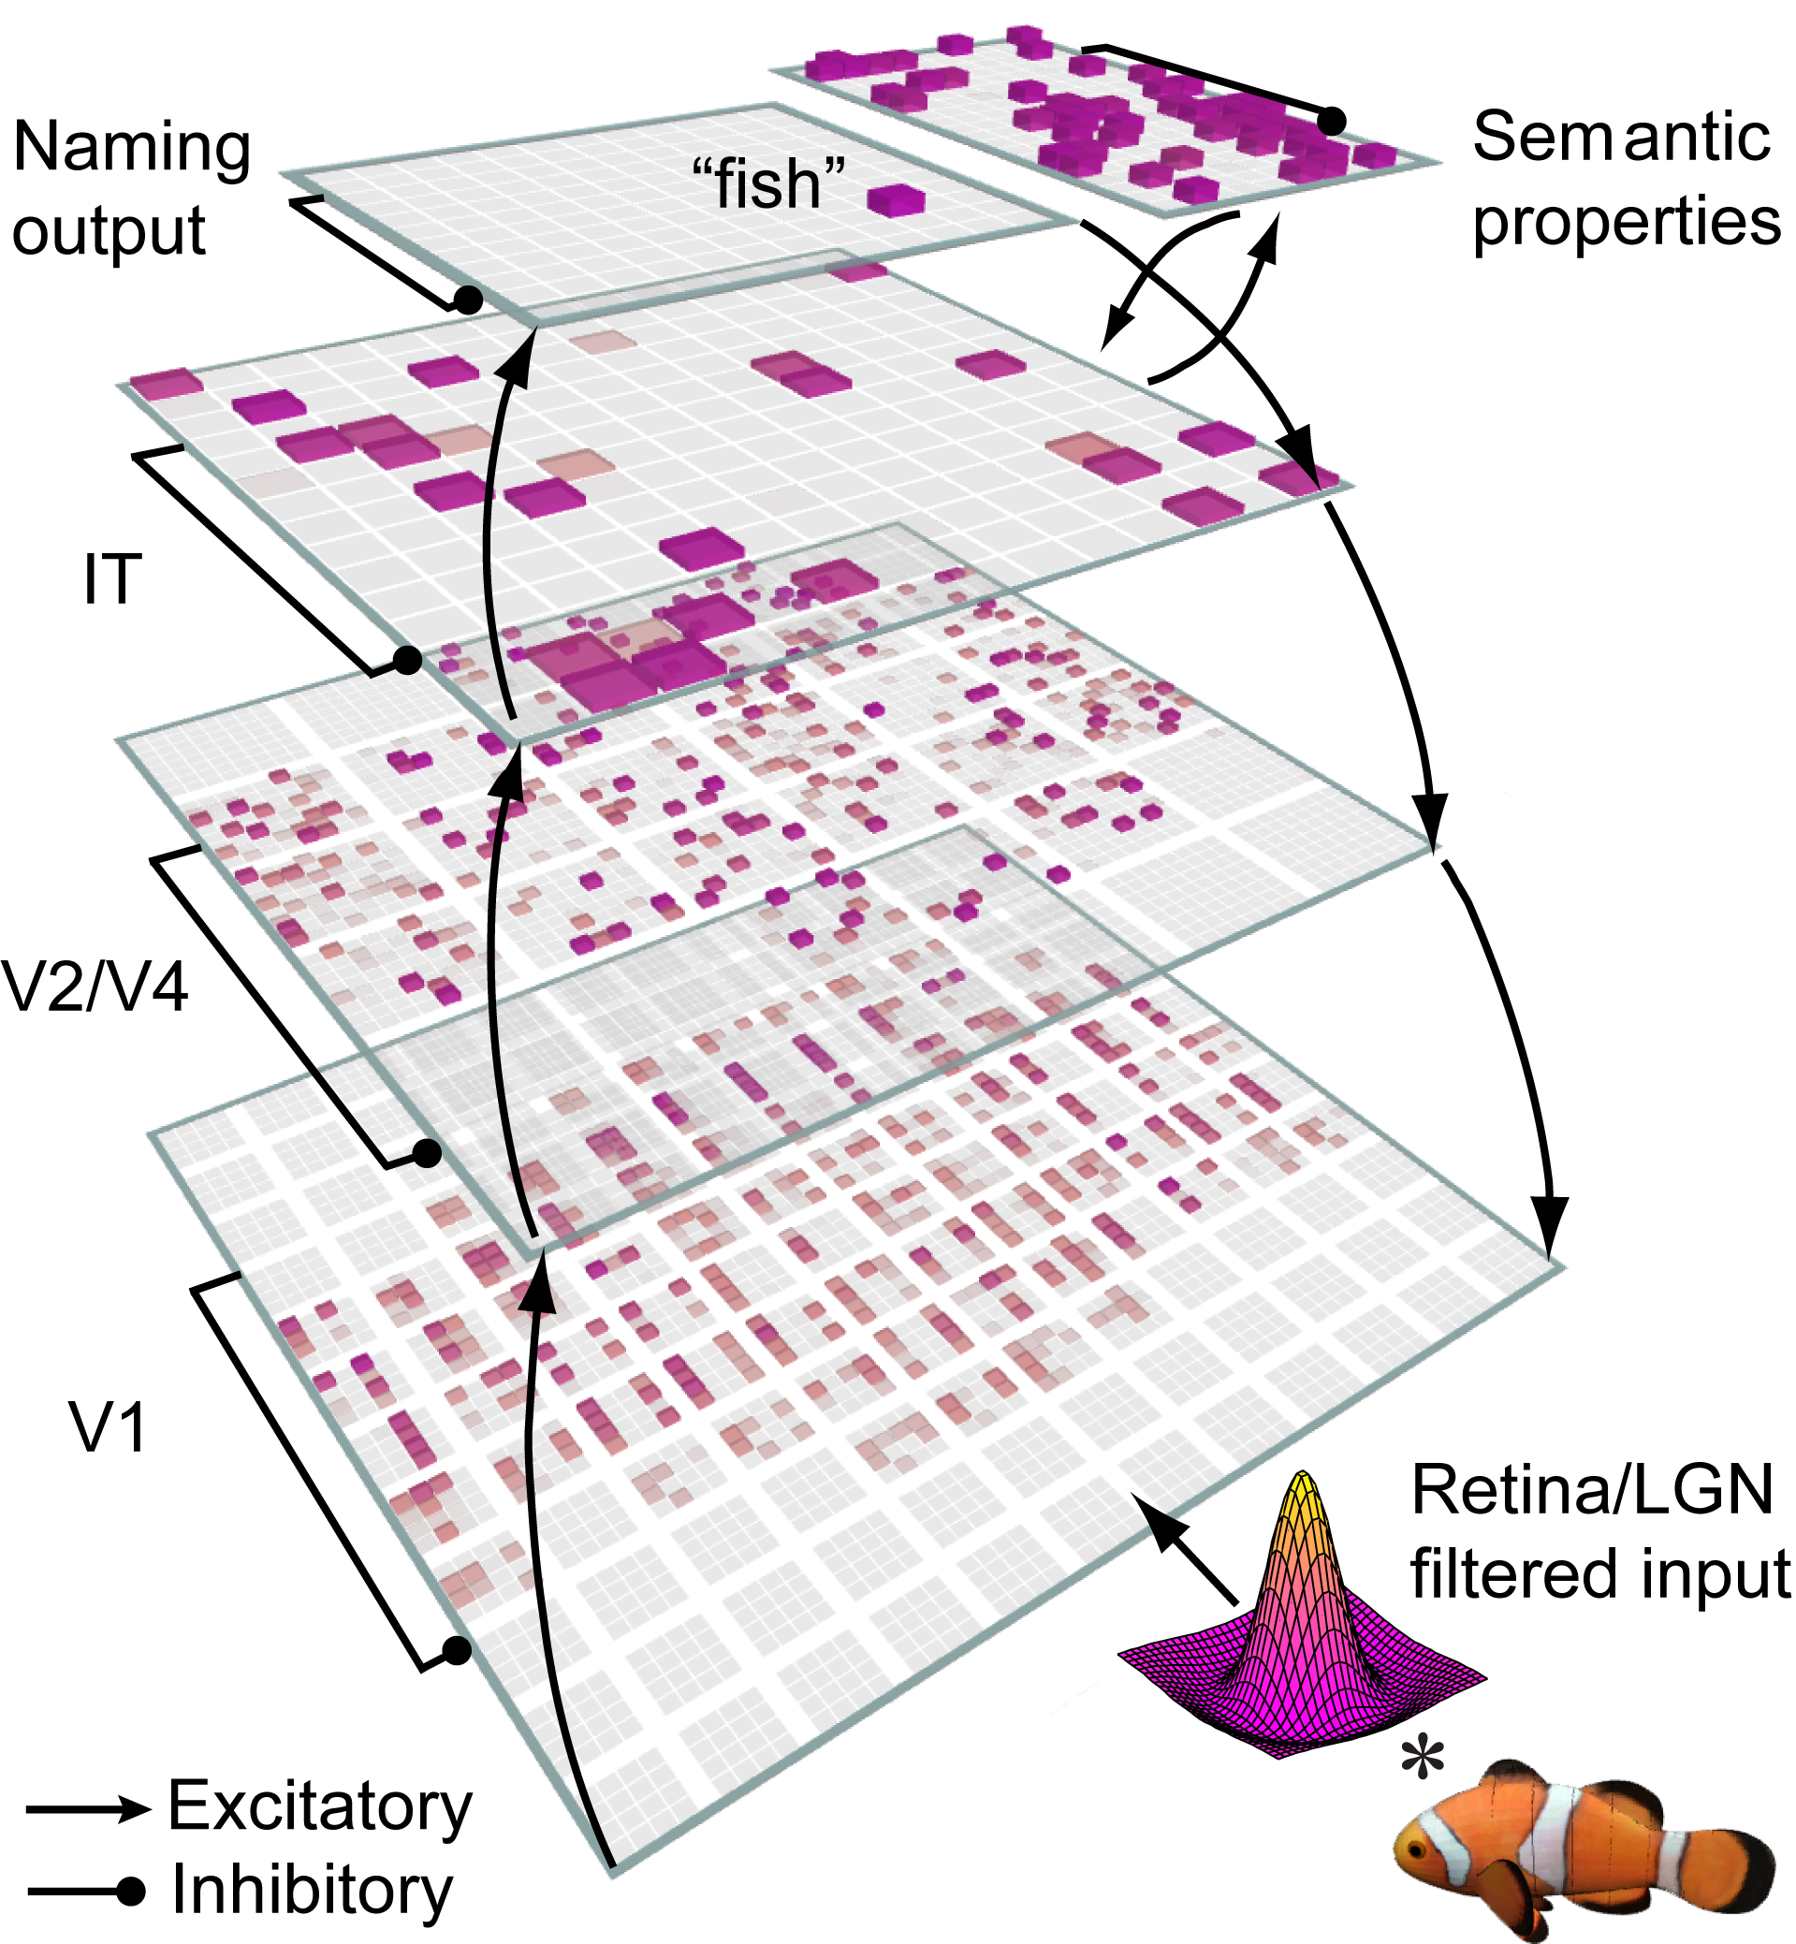
Bidirectional Object Recognition (e.g., O’Reilly et al., 2013)
High-performance 100-way invariant object recognition

Slide 12
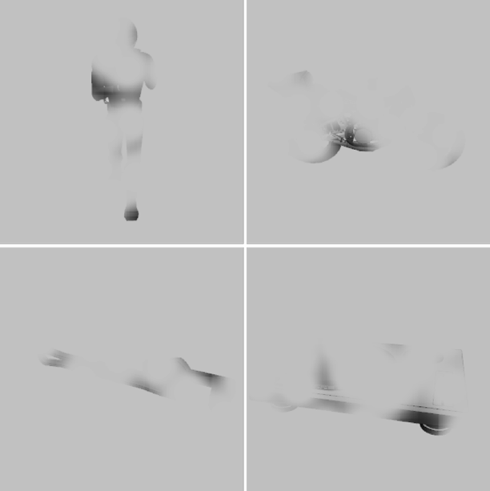
Benefit of Bidirectionality: Robust to Partial Occlusion

Slide 13
Human Data

Slide 14
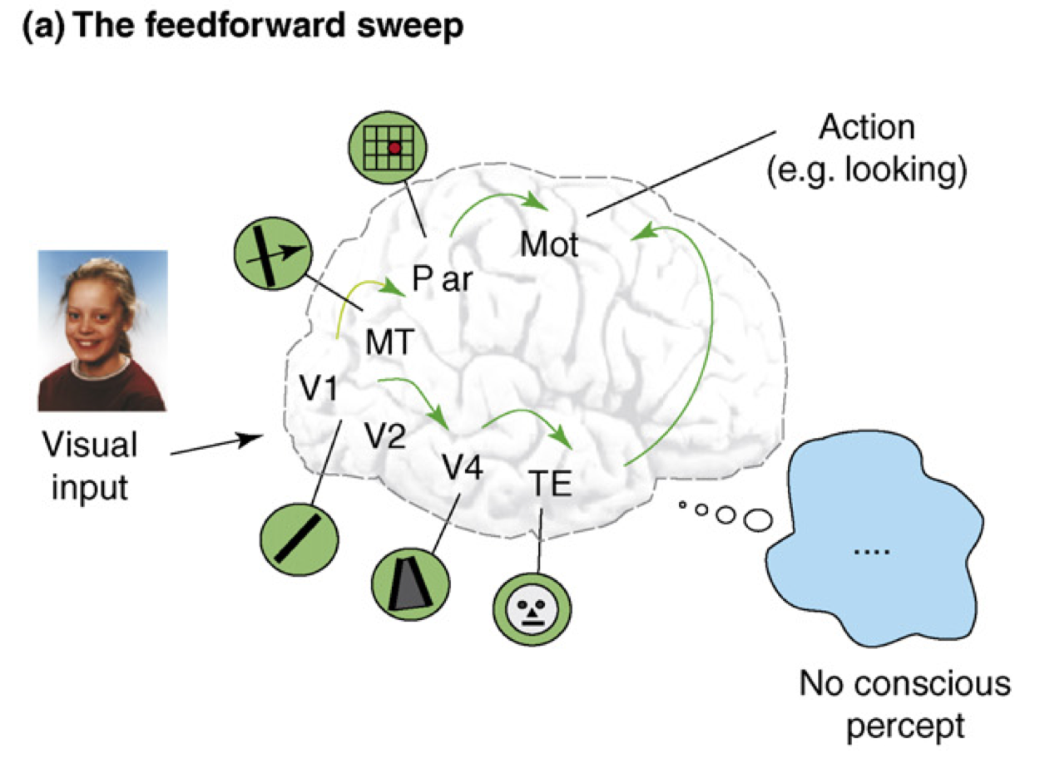
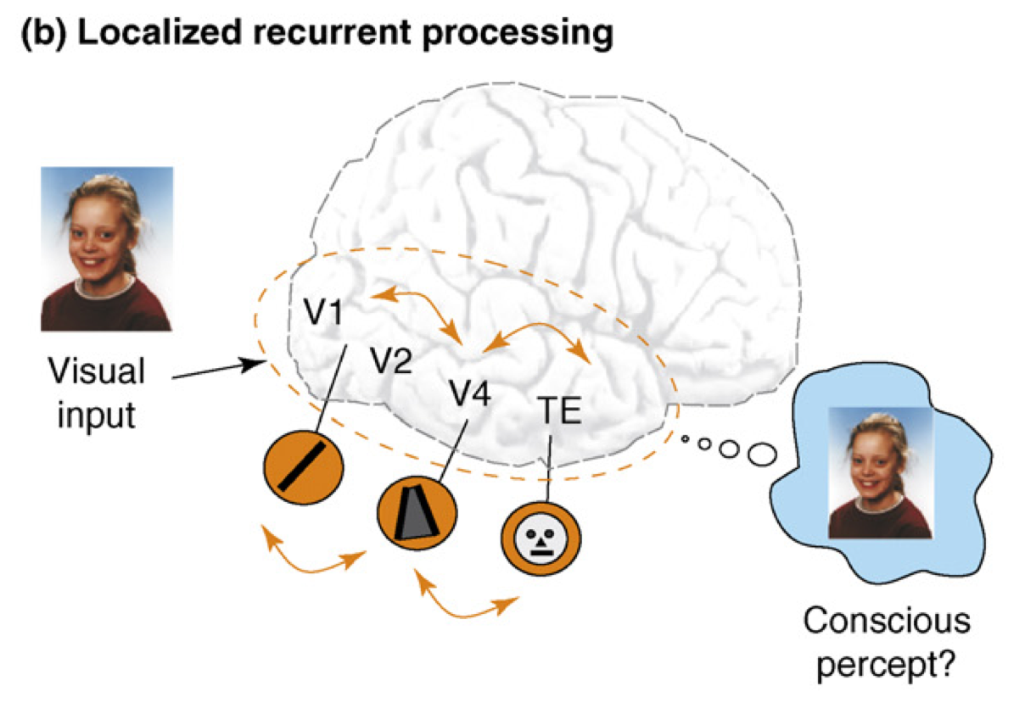
Recurrent Processing = Consciousness (Lamme, 2006)
Consciousness is Unitary
Recurrence coordinates all areas on one thing (emerges via popular vote)
Consciousness is Functional
Helps organize, prioritize behavior – “focusing” key for difficult problems
Consciousness Flows
Temporal dynamics and information processing (multi-step cognition)

Slide 15
Problems with Recurrent Connectivity
Computationally much slower than feedforward
Could really use fast specialized hardware!
But algorithms are under rapid development..
Much more complex dynamics: learning problem is much more difficult

Slide 16
Overview
Three major biological problems:
How to propagate errors? (solved; O’Reilly, 1996)
How does local synaptic plasticity work? (XCAL?)
Where do supervised target values come from?

Slide 17
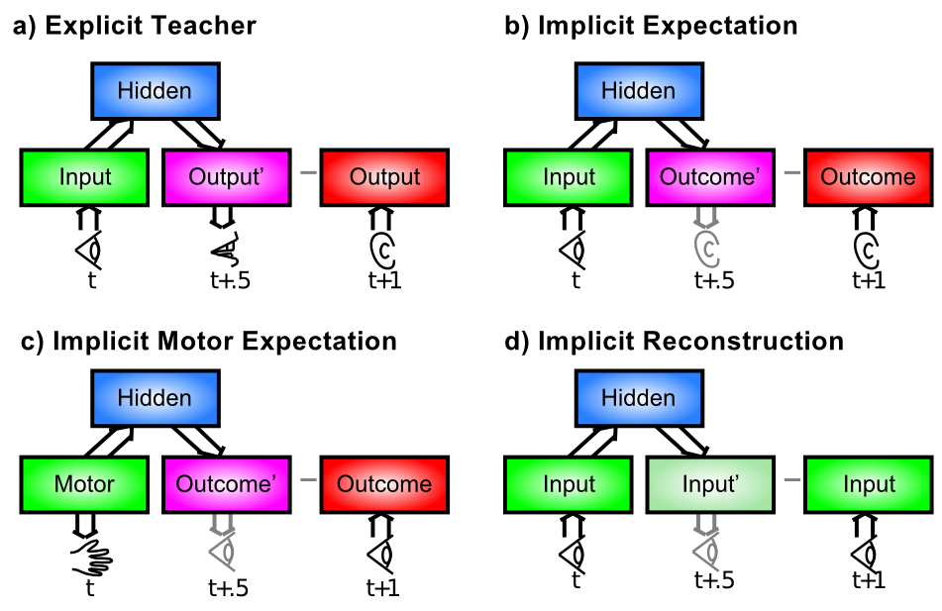
Where do the Targets Come From?

Slide 18
The Bootstrap Solution
How do the high-level “outputs” get active?
From a sensory modality (e.g., auditory input)
Infinite regress: need high-level training of that!
Solution: need to bootstrap our way up to multi-modal mutual-training systems (c.f., Becker, de Sa)
Now we just need a way for sensory modalities to train themselves… and Hebbian learning isn’t up to the task.

Slide 19
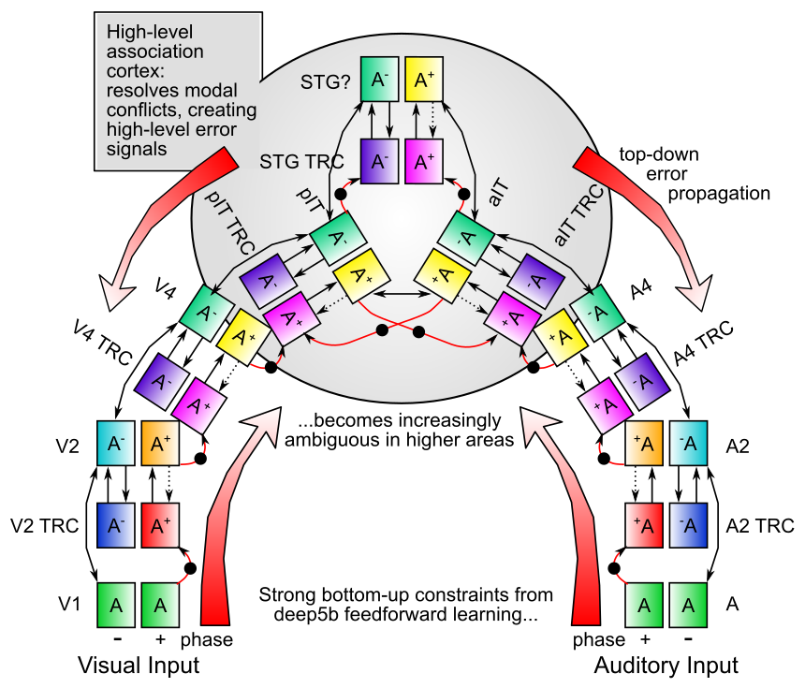

Slide 20
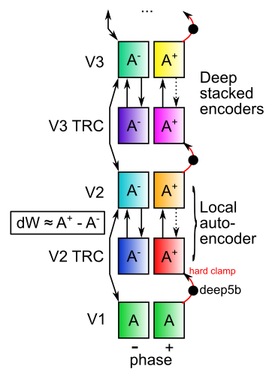
Nested Thalamic Auto-Encoders (Deep5aed: Deep5b Auto Error Driven)
Each layer learns by auto-encoding the layer below (c.f., restricted Boltzmann machines)
Plus phase target: Deep layer 5b neocortical neurons (intrinsic bursting, 10Hz alpha rhythm): drivers of thalamic relay cell (TRC) firing at next feedforward layer (Sherman & Guillery)
Minus phase: weaker but much more numerous layer 6 -> TRC

Slide 21
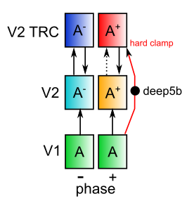
Nested Thalamic Auto-Encoders (Deep5aed: Deep5b Auto Error Driven)
Really is a standard auto-encoder!

Slide 22
Nested Thalamic Auto-Encoders (Deep5aed: Deep5b Auto Error Driven)
Advantages:
Automatic, internal – / + phases
deep5b bursting = amplification of error signals – each layer has own local error
Encoding is done on reduced, transformed version of prior layer -> greater abstraction
Full bidirectional constraint satisfaction across network contributes to minus phase
and plus phase: supports both local and distal learning

Slide 23
Nested Thalamic Auto-Encoders (Deep5aed: Deep5b Auto Error Driven)
Advantages:
Each layer is more strongly constrained – should improve generalization and overall robustness – e.g., object recognition operates on “2.5d sketch” of visual world, not just on pixels or gabor jets
Fixes “adversarial image” problem?

Slide 24
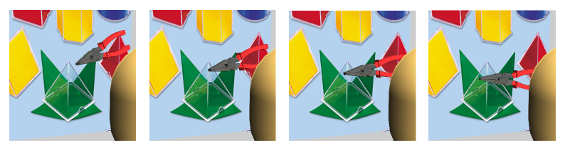
Auto-Encoder over Time: Predictive Learning
Predictive learning creates nearly infinite supply of challenging learning problems: can learn a lot about physics and visual structure
Widely exploited idea: Helmholtz, Elman, Hawkins…
Requires encoding of prior context for future prediction
LeabraTI: temporal integration – also uses deep5b bursting

Slide 25
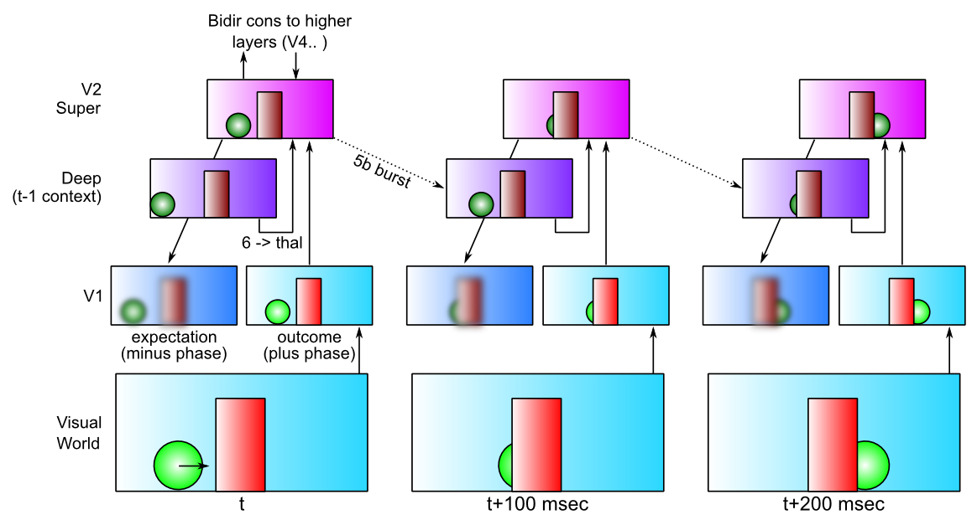
LeabraTI: Learning Through Time

Slide 26
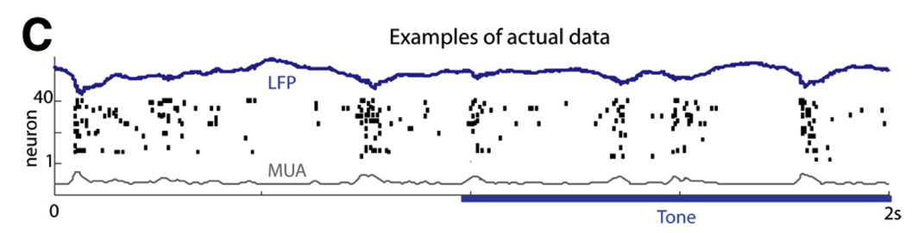
TI: Key Biological Data
Alpha freq dominant in deep layers (e.g., Buffalo et al, 2011).
Sustained auditory tones discretized into alpha “packets” (Luczak et al, 2013)
Many indications of discretization in perception (Van Rullen & Koch, 2003)
Predictive coding during saccades
Deep5b alpha bursting to a continuous auditory tone (Luczak et al, 2013):

Slide 27
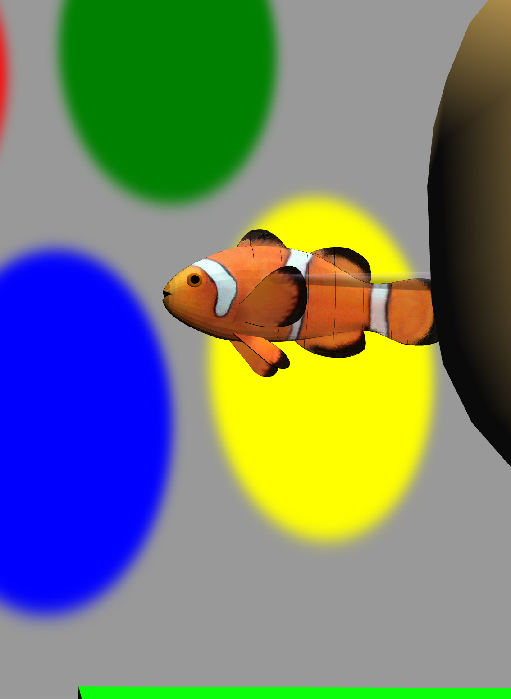
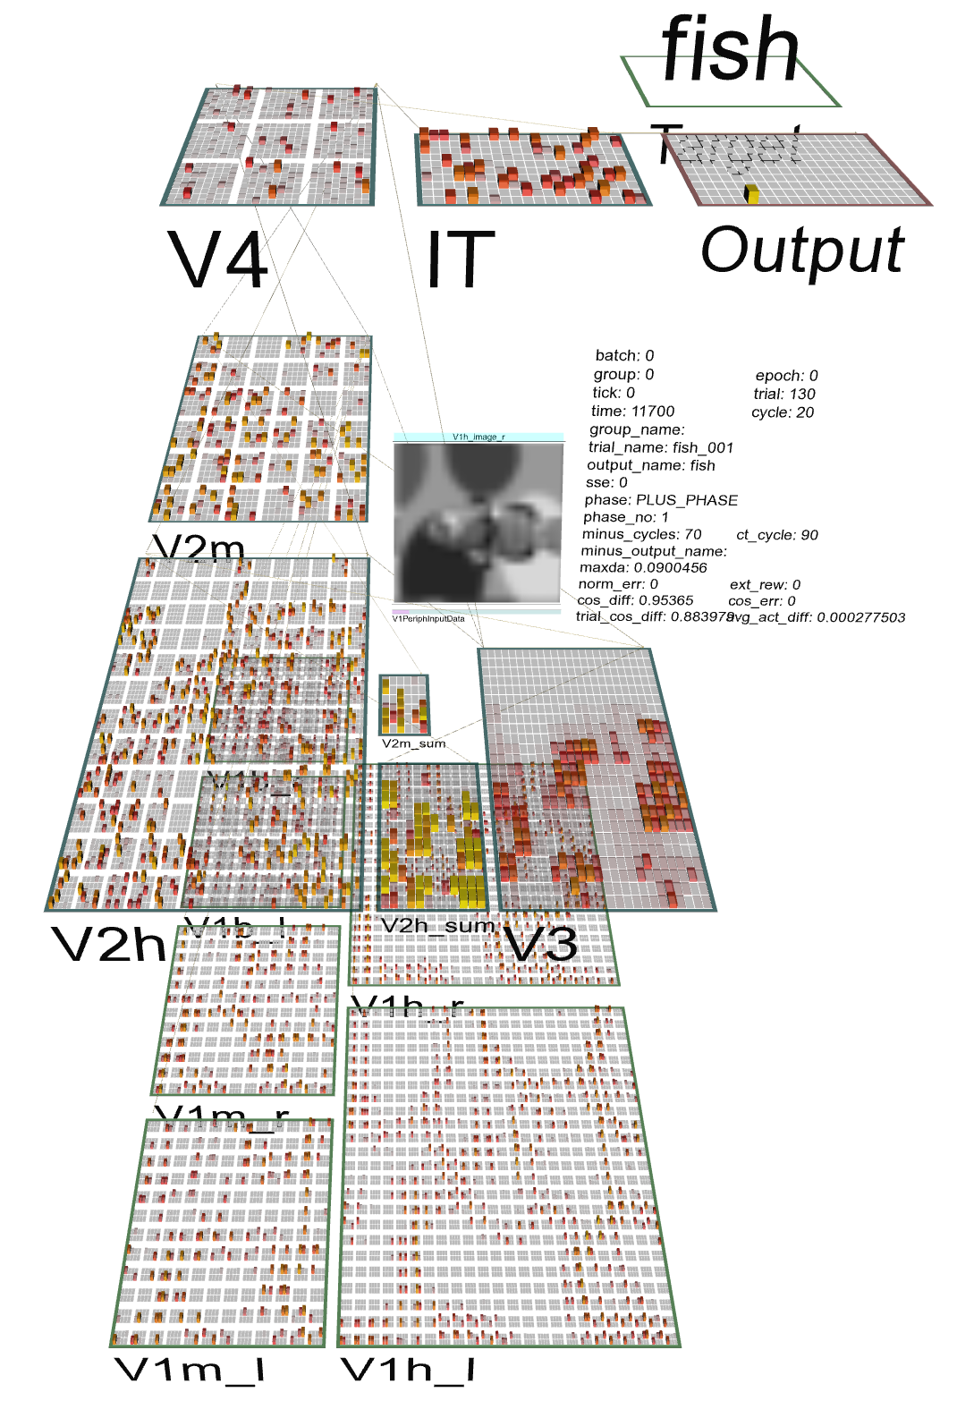
Test Application: Learning Early Visual Structure

Slide 28
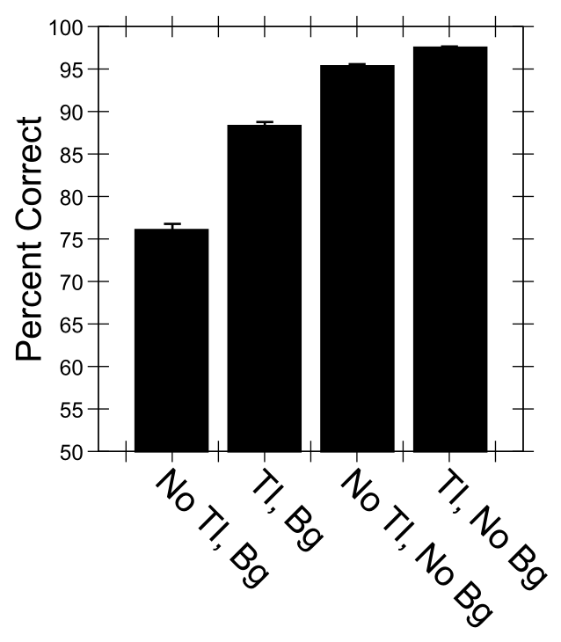
Predictive Auto-Encoding Supports Figure-Ground Segregation
Bg = backgrounds present
No Bg = Not
Differential advantage of TI for backgrounds present case

Slide 29
Conclusions
Detailed thalamocortical mechanisms can support predictive auto-encoder error-driven learning: lots of testable predictions!
Could bootstrap all the way to multi-modal mutual error-driven learning
Ability to learn early visual structure (surfaces, depth, etc) = better object recognition in cluttered visual scenes

Slide 30
Thalamocortical Mysteries
What is function of the alpha rhythm (10Hz)?
Drives automatic, internal error-driven learning
Why does higher-order thalamus have a few strong driver inputs, and far more weaker ones?
Drivers = hard clamped plus phase target
Why are these drivers non-plastic?
Plus phase target does not itself have a target..
Same thalamocortical mechanisms reconfigured in PFC, with Basal Ganglia input, to do variable binding!

Slide 31
Thanks To
CCN Lab
Tom Hazy
Seth Herd
Tren Huang
Dave Jilk (eCortex)
Nick Ketz
Trent Kriete
Kai Krueger
Brian Mingus
Jessica Mollick
Wolfgang Pauli
John Rohrlich
Sergio Verduzco-Flores
Dean Wyatte
Funding
ONR – Hawkins
ONR – McKenna & Bello
IARPA – ICArUS
ARL RCTA
NIMH P50-MH079485

Slide 32
Extras

Slide 33
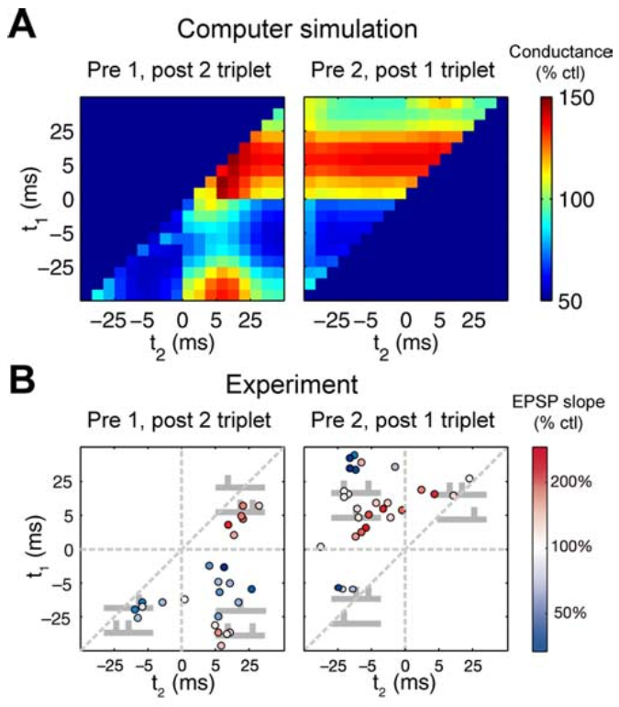
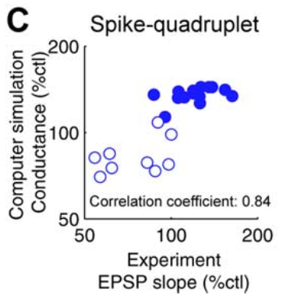
“Allosteric” NMDA Captures STDP (including higher-order and time integration effects)

Slide 34
Differences from HTM
Dendritic spines linearize neuron behavior (Araya, Eisenthal, Yuste, 2006)
Point neurons! They work! (but we do take advantage of differential strength for diff prjns)
Error-driven learning and graded bidirectional constraint satisfaction vs. discrete coincidence detection and discrete activations
More differentiated laminar functionality

